Slide 1
Computer Architecture
and Organization
Introduction
Md. Khademul Islam
Professor of CSE, RU

Slide 2
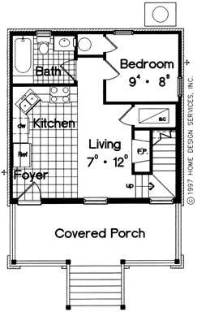
What is Computer Architecture?

Slide 3
Architecture and Organization
•Architecture is the design of the system visible
to the assembly level programmer
What instructions
How many registers
Memory addressing scheme
•Organization is how the architecture is
implemented
How much cache memory
Microcode or direct hardware
Implementation technology

Slide 4
Same Architecture
Different Organization
•Almost every program that can run on an
original Pentium (or 8088) can run on an Intel i7
•All computers in the Intel Pentium series have the same architecture
•Each version of the Pentium has a different
organization or implementation

Slide 5
Same Architecture
Different Organization
•The IBM 360 computer was released in several
different models
•All had the same architecture. A program compiled on one IBM 360 would run on all models.
•The different models had different implementations, speed and price

Slide 6
Basic Computer Components
CPU
Cache
Bus
I/O Device
I/O Controller
Memory

Slide 7
Central Processing Unit (CPU)
•Contains the control logic that initiates most
activities in the computer
•The Arithmetic Logic Units (ALU) perform the
math and logic calculations
•Registers contain temporary data values
•Program Counter register contains the address of the next instruction to execute

Slide 8
Registers
•The CPU has registers to temporarily hold data
being acted upon
•Different architectures have different number
of registers
•Some registers are available for the user programs to use directly
•Some registers are used indirectly (such as the
program counter)
•Some registers are used only by the operating
system (i.e. program status reg)

Slide 9
Bus
•The bus is a set of parallel wires that connect
the CPU, memory and I/O controllers
•It has logic (the chipset) to determine who
can use the bus at any given instant
•The width of the bus determines the maximum memory configuration

Slide 10
I/O Controllers
•Direct the flow of data to and from I/O
devices
•CPU sends a request to the I/O controller to
initiate I/O
•I/O controllers run independently and in parallel with the CPU
•I/O controllers may interrupt the CPU upon completion of request or error

Slide 11
Memory
•The internal memory is Random Access
Memory (RAM)
•Both data and program instructions are kept
in RAM
•Instructions must be in RAM to be executed

Slide 12
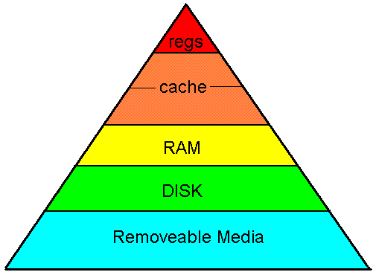
Memory Hierarchy

Slide 13
Instruction Cycle
•Fetch the instruction from memory
•Execute the instruction

Slide 14
Instruction Cycle (more detail)
•Fetch the instruction from the memory
address in the Program Counter register
•Increment the Program Counter
•Decode the type of instruction
•Fetch the operands
•Execute the instruction
•Store the results

Slide 15
Simple Model of Execution
•Instruction sequence is determined by a
simple conceptual control point
•Each instruction is completed before the next
instruction starts
•One instruction is executed at a time

Slide 16
Layers
You can consider computer operation at many
different levels
Applications
Middleware
High level languages
Machine Language
Microcode
Logic circuits
Gates
Transistors
Silicon structures

